Slide 1
Hollywood's Most Profitable Stories Case Study
Notes:
This presentation was automatically generated by PowerPoint Copilot based on content found in this document: https://hp-my.sharepoint.com/personal/sishira_mishra_hp_com/Documents/Personal/PES/Tablue/DVT/HollyWood%20Most%20Protfolio%20Case%20Study.pdf AI-generated content may be incorrect.

Slide 2

Introduction and Team: Team Members
Team Member
Sishira Mishra
Gopinatha Tejasvi G M
Girish Chandra Mundadi
Lokesh G
Ashly P Eldho
Notes:
Our team consists of Sishira Mishra, Gopinatha, Girish Chandra, Lokesh G, Ashly P Eldho, Tejasvi G M, and Mundadi. Original Content: Introduction and Team Team Members Sishira Mishra Gopinatha Girish Chandra Lokesh G Ashly P Eldho Tejasvi G M Mundadi

Slide 3
Agenda
Agenda
Problem Statement
Introduction and Team
Data Overview
Data Analysis and Visualization
Insights and Answers
Conclusion
Notes:
Agenda * Agenda * Problem Statement * Introduction and Team * Team Members * Team Images * Data Overview * Data Analysis and Visualization * Null Values * Animation Genre * Highest Revenue Genre * Earnings Trends * Insights and Answers * Comedy Genre Earnings * Highest Grosser in Action Genre * Average & Median Gross Revenues * Increasing Revenue Trend * Conclusion

Slide 4

Problem Statement
Analysis Goals
Explore Hollywood's visualization techniques
Identify key trends and insights
Key Tasks
Determine most profitable genres
Assess earnings trends over time
Calculate gross revenues and profitability for specific genres
Insights
Understand factors contributing to box office success
Guide future movie production strategies
Notes:
The goal of this analysis is to explore Hollywood's visualization techniques to identify key trends and insights related to movie genres, revenue generation, and profitability ratios. Key tasks include determining the most profitable genres, assessing earnings trends over time, and calculating gross revenues and profitability for specific genres like comedy and action. The insights gained will guide future movie production strategies. Original Content: Problem most profitable movies through data The goal of this analysis is to explore Hollywood's visualization techniques. The analysis aims to Statement: identify key trends and insights related to movie genres, revenue generation, and profitability ratios. Key tasks include determining the most profitable genres, assessing earnings trends over time, and calculating gross revenues and profitability for specific genres like comedy and action. The insights gained from this analysis will provide a deeper understanding of the factors that contribute to box office success and guide future movie production strategies.

Slide 5
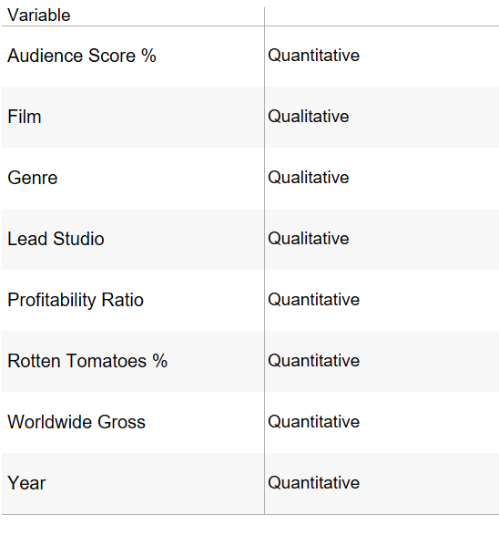
Data Overview
Types of Variables:
Quantitative Variables (Numerical):
Audience Score %: Represents the percentage score given by the audience. It is a continuous variable.
Profitability Ratio: Represents the ratio of profit, indicating how much profit was made. It is a continuous variable.
Rotten Tomatoes %: Represents the percentage score given by critics on Rotten Tomatoes. It is a continuous variable.
Worldwide Gross: Represents the total gross revenue earned worldwide. It is a continuous variable.
Year: Represents the year of release of the film. It is a discrete variable (since it represents a countable number of years).
Qualitative Variables (Categorical):
Film: Represents the name/title of the movie. It is a nominal variable.
Genre: Represents the genre of the movie (e.g., Comedy, Drama, Romance). It is a nominal variable.
Lead Studio: Represents the studio that produced the movie (e.g., Fox, Universal, Independent). It is a nominal variable.
Other:
In this dataset, there are no other types of variables like ordinal
Notes:
This slide provides an overview of the data and identifies the types of variables present. Original Content: Data Overview Identify the types of variables present

Slide 6
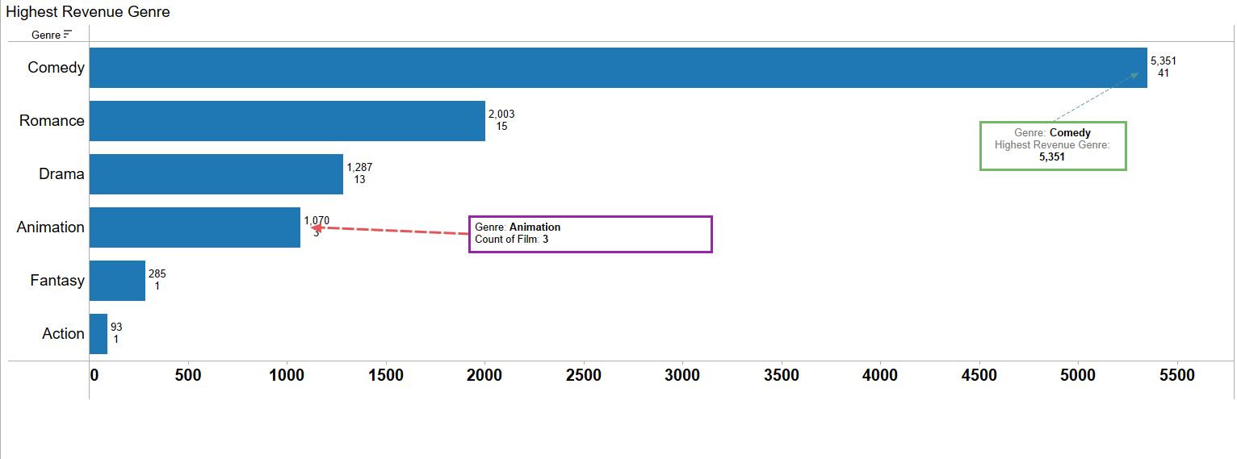
Data Analysis and Visualization: Highest Revenue Genre
Insights on Revenue Generation
Highest revenue genre identified
Genre: Comedy
Graphical Representation
Bar graph to illustrate revenue distribution
Notes:
The highest revenue-generating genre is Comedy. A bar graph will be prepared to illustrate the revenue distribution across different genres. Original Content: Insights: Highest revenue Genre: Comedy Prepare a bar graph and identify highest revenue generating genre

Slide 7
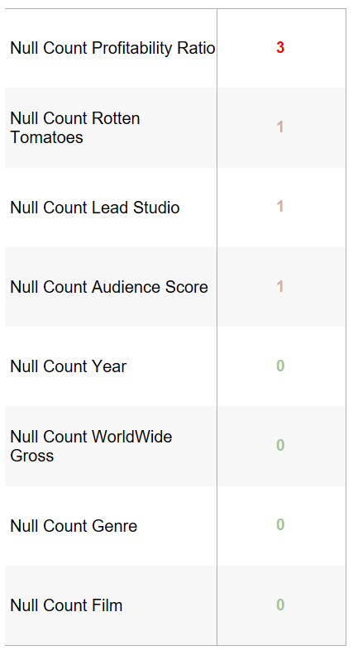
Data Analysis and Visualization: Null Values
Profitability Null Values
3 Null values identified
Rotten Tomatoes Null Values
1 Null value identified
Lead Studio Null Values
1 Null value identified
Audience Score Null Values
1 Null value identified
Other Variables Null Values
No Null values identified
Notes:
The analysis identified null values in several variables. Profitability has 3 null values, while Rotten Tomatoes, lead Studio, and Audience Score each have 1 null value. All other variables have no null values. Original Content: Data Analysis and Visualization Which variable has null values How many null values does Tableau identify in this complete dataset Summary: • Profitability has 3 Null value • Rotten Tomatoes, lead Studio, Audience Score has 1 Null value each • All other has no Null value

Slide 8
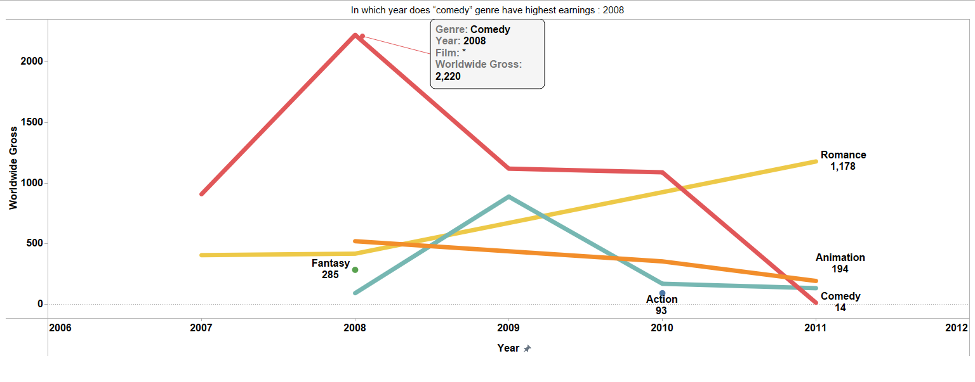
Data Analysis and Visualization: Earnings Trends
Plot a line graph with earnings trends of moving genres from year 2007 to 2011
Notes:
This slide presents a line graph illustrating the earnings trends of moving genres over the period from 2007 to 2011. Original Content: Plot a line graph with earnings trends of moving genres from year 2007 to 2011

Slide 9
Insights and Answers: Comedy Genre Earnings
Question 1 | Answer
In which year does “comedy” genre have highest earnings | 2008 is the where Comedy Genre had a highest profit
Notes:
This slide presents insights and answers. Original Content: Insights and Answers

Slide 10
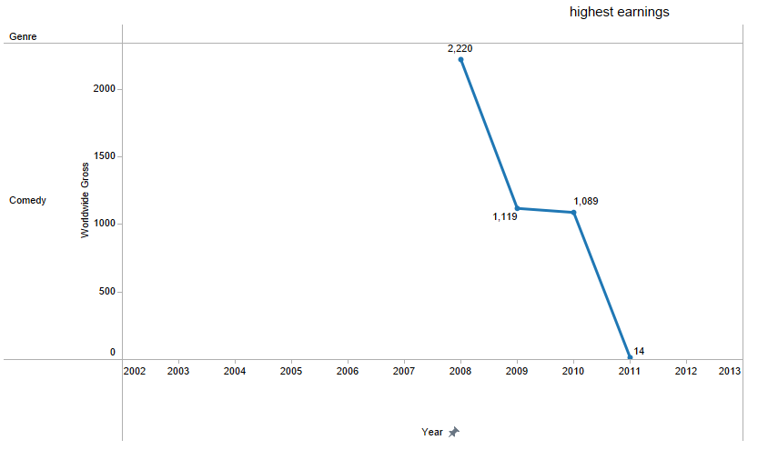
Question 1 - Visual

Slide 11
Insights and Answers: Highest Grosser in Action Genre
Question 2 | Answer
Which movie is highest grosser in “action” genre | Killers is the move having highest Gross in “action”. This is also only one move in our dataset for Action Genre.

Slide 12
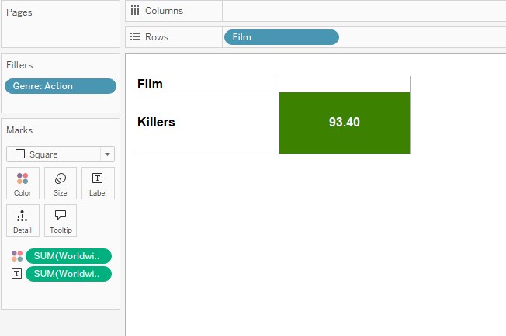
Question 2 - Visual

Slide 13
Insights and Answers: Average & Median Gross Revenues
Question 3 | Answer
What are average & median gross revenues of movies in “comedy” and “action” | Comedy: Avg Gross: 130.50 Median Gross: 79.18 Action: Avg Gross: 93.40 Median Gross: 93.40

Slide 14
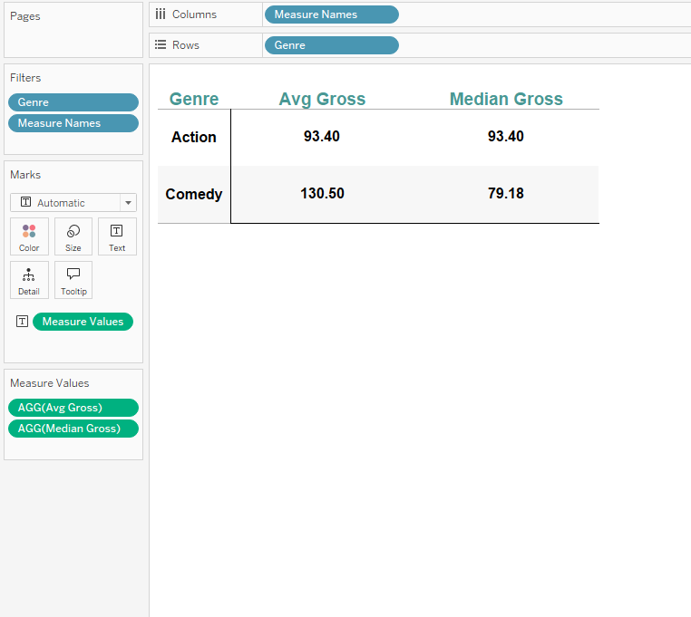
Question 3 - Visual

Slide 15
Insights and Answers: Increasing Revenue Trend
Question 4 | Answer
Which movie genre had an increasing revenue from year 2008 - 2011 | Romance movie is having increasing revenue trend from 2008 - 2011

Slide 16
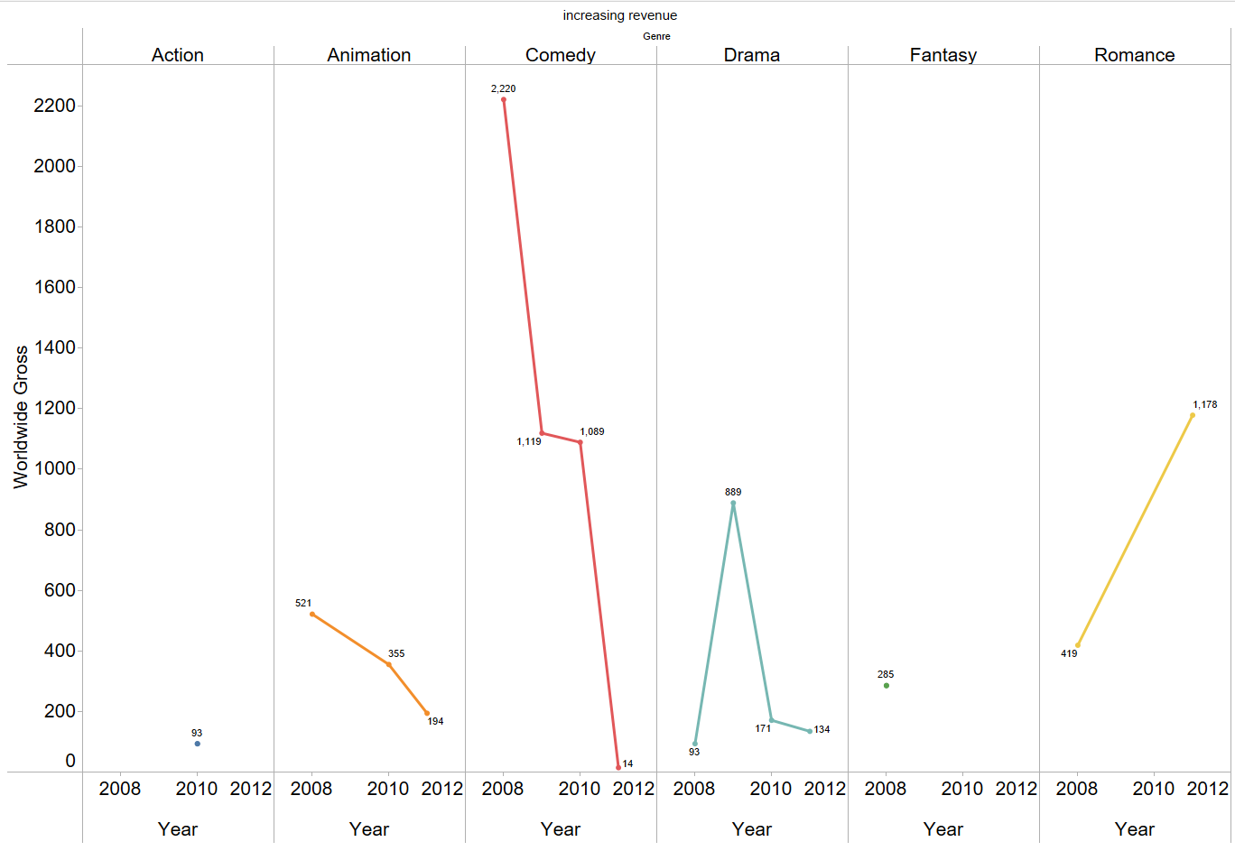
Question 4 - Visual

Slide 17
Conclusion
Thank You
Notes:
Thank you for your attention and time. Original Content: Thank You

Slide 18
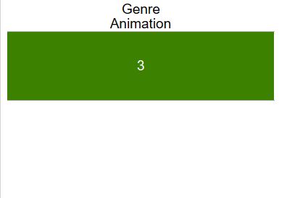
Data Analysis and Visualization: Animation Genre
Total number of movies in the Animation genre
Based on the dataset
Count is 3
Notes:
The total number of movies in the Animation genre, based on the dataset, is 3. Original Content: Identify total number of movies in animation genre Insights: Total number of movies in the "Animation" genre, which is 3 based on your dataset.

